Slide 1
Presentation Skills:
How to Keep Your Audience Awake, Alert, and Informed
Kelley Branch, MD, MS
Division of Cardiology
University of Washington

Slide 2
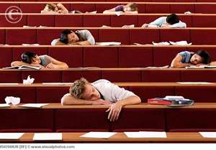
What to Avoid
Another riveting lecture by Dr. Branch

Slide 3
Outline
Know your audience
Presentation skills to keep them awake
Powerpoint slides
  Tips and tricks

Slide 4
Presentation Skills
Know your audience
  Ask beforehand
  Tailor to level and interest
    Experts – Heavy on data
    Not so expert – “What do I need to know”
    Q: “So…when do we use this?”

Slide 5

Presentation Skills: Know Your Material
Focus on the message (10% rule)
Know your topic well enough to explain it and answer questions
  Requires adequate preparation
Address your own questions as you prepare
Run under time
  5-10 minutes for discussion
  Have an “out”. Know what to skip

Slide 6
Who Are You?
Lecture Styles to Avoid
Fixes
Monotone
Soft talker/Mumbler
Enzo (Ferrari)
Chatty Cathy or Ken
Verbal tic (“Basically…”)
The Wanderer
Screen talker
Watch the news
Pick one portion of every slide to emphasize
This is not your living room
Have friend “critique”
Keep an eye on the mic and the back walls

Slide 7
Presentation Skills
Speak clearly
SLOW DOWN
  Tempo equal to a news anchor
Talk to people or mic, not screen(s)
Talk to the back of the room
Use the pause
Enthusiasm is Infectious

Slide 8
Presentation Skills
Involve the audience
  Small room – eye contact to everyone
  Large room – split audience into 3rds
  Find the “nodder”
Minimize hands and movements, like props
Avoid lecturalgia

Slide 9

Large or National Meetings
Sit up and forward
Acknowledge meeting and moderators
Engage from the start
  Use greeting or phrase in native language
Keep same distance from mic
Organize to run under time
  No one cares about data if running late

Slide 10
BRAIN BREAK
About every 10-15 minutes
May use outline slide
Use cartoons or pictures
  Make a point with it
Question as a transition

Slide 11
Powerpoint Slides

Slide 12
Powerpoint Slides: Why?
A means to an end
  Try to effectively and succinctly communicate data
Entertainment
A picture is not limited to 1000 words
Prompt for ideas
Good example: An Inconvenient Truth

Slide 13
Powerpoint Outline
Tell them you are going to tell them, tell them, and tell them you told them
Hints for good presentations
Slidemaking rules
Choosing slide parameters
Tables, Graphs, Pictures
Think HAIKU!

Slide 14
Powerpoint Outline
Tell them you are going to tell them, tell them, and tell them you told them
Hints for good presentations
Slidemaking rules
Choosing slide parameters
Tables, Graphs, Pictures
Think HAIKU!

Slide 15
Hints for Good Presentations
10% Rule – What 10% from presentation are the take away points?
Limit points to bare minimum
  Phrases OK, sentences not
Make it BIG, SIMPLE, CLEAR
Enjoy and embrace space

Slide 16
Hints for Good Presentations
10% Rule – What 10% from presentation are the take away points?
Limit points to bare minimum
  Phrases OK, sentences not
Make it BIG, SIMPLE, CLEAR
Enjoy and embrace space

Slide 17
Rules/Guidelines for Slides
8 foot rule -- Try to read a printout at 8 feet
Titles: 44 points +/- 4
Body: 32 points +/- 4
Font selection – Avoid kerned/serif fonts
  Use Arial or Helvetica, NOT Times New Roman or Courier
32 point font

Slide 18
Fonts - 44
Serif Font: Times New Roman – 36
Times New Roman - 28
Times New Roman - 20
Times New Roman - 12
Non-serif font: Arial - 36
Arial – 28
Arial – 20
Arial - 12

Slide 19
Rules (cont.)
Total number of lines -> try to limit to 6-8
Use the entire slide, they are cheap!
Emphasis
  bold fonts, italic fonts, or different colors. NOT underlining
Use animation sparingly
Use shadowing of text, slides look less flat

Slide 20
Rules (cont.)
Total number of lines -> try to limit to 6-8
Use the entire slide, they are cheap!
Emphasis
  bold fonts, italic fonts, or different colors. NOT underlining
Use animation sparingly
Use shadowing of text, slides look less flat

Slide 21
BRAIN BREAK
About every 10-15 minutes
May use outline slide
Use cartoons or pictures
  Make a point with it
Question as a transition

Slide 22
How does obesity affect our patients?

Slide 23
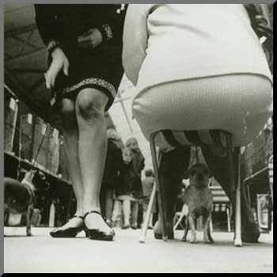
Obesity and Cardiovascular Risk
Your patient?
Or your patient?

Slide 24
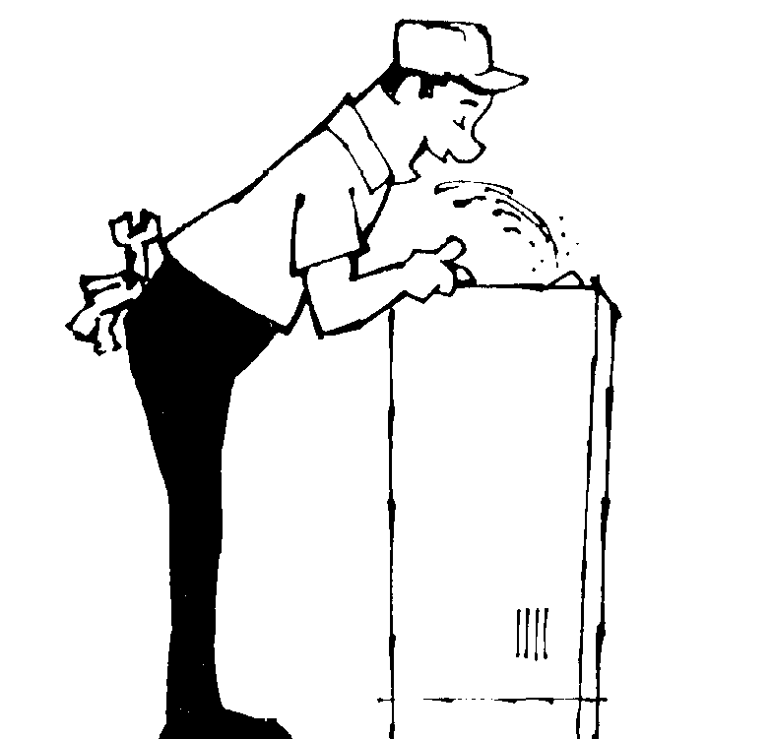
The “Ideal” World
Statin

Slide 25
The Really Ideal World
Statin
Prozac
Vicodin
Viagra

Slide 26
Backgrounds
Use a color and contrasting font
  Darker background colors, avoid black and white
Avoid “Background As The Presentation”
Careful with gradients
Try palettes on Powerpoint
  Be cautious, simple is better
  View your slideshow from across the room

Slide 27
Backgrounds
This is classic and works
Stark contrast of back type
White background fatigues the eyes after ~30 minutes

Slide 28

Backgrounds
Who here is annoyed?
It is probably good for subliminal text
Even dark is annoying…

Slide 29
Therapeutic methods in ischaemic MR
Medical treatment
* Vasodilators :
It could be hypothesised that the effects of vasodilators on ventricular dimensions and remodelling could reduce the area of the regurgitant orifice, while this is not the case in organic mitral regurgitation.
Most studies have demonstrated a decrease in the regurgitant fraction and/or LV volumes after 3–12 months using ACE inhibitors or AT1 receptor blockers.

Slide 30

Backgrounds
Any questions….
Comments….

Slide 31
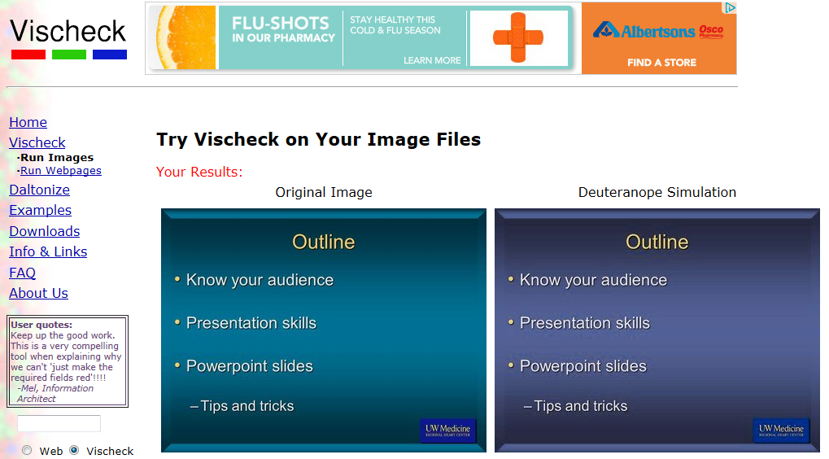
Powerpoint Colors
Average 3 colors per slide
Emphasis with bold colors
Color blindness
  Avoid greens, reds, purples
Colors internationally may have different meanings
http://www.vischeck.com/vischeck/vischeckImage.php

Slide 32
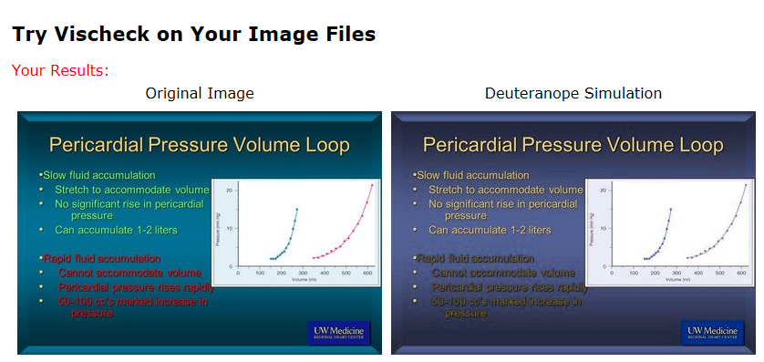
Pericardial Pressure Volume Loop
Slow fluid accumulation
Stretch to accommodate volume
No significant rise in pericardial pressure
Can accumulate 1-2 liters
Rapid fluid accumulation
Cannot accommodate volume
Pericardial pressure rises rapidly
50-100 cc’s marked increase in pressure

Slide 33
Hints for Powerpoint

Slide 34
Slides
PowerPoint is a great tool – but it isn’t the point of the presentation

Slide 35
Slides
PowerPoint is a great tool – but it isn’t the point of the presentation
The audience will read your slide instead of listening to you

Slide 36
Slides
PowerPoint is a great tool – but it isn’t the point of the presentation
The audience will read your slide instead of listening to you
Use font, pictures, custom animation, etc. with visual appeal, but don’t go overboard

Slide 37
Powerpoint Slides: Pitfalls
Avoid the obstipated slide
  No more than two graphs on a slide
Avoid simply reading the slide
Avoid "Laser Light Shows”
  Mouse pointer if large venue, >1 screen
Backup, backup, backup!
  On computer, email to yourself, CD/Zip/USB

Slide 38
Some Powerpoint Specifics and Examples

Slide 39
Powerpoint Outline
Tell them you are going to tell them, tell them, and tell them you told them
Hints for good presentations
Slidemaking rules
Choosing slide parameters
Tables, Graphs, Pictures
Think HAIKU!

Slide 40
The Major Point of the Talk
Chest pain is bad

Slide 41

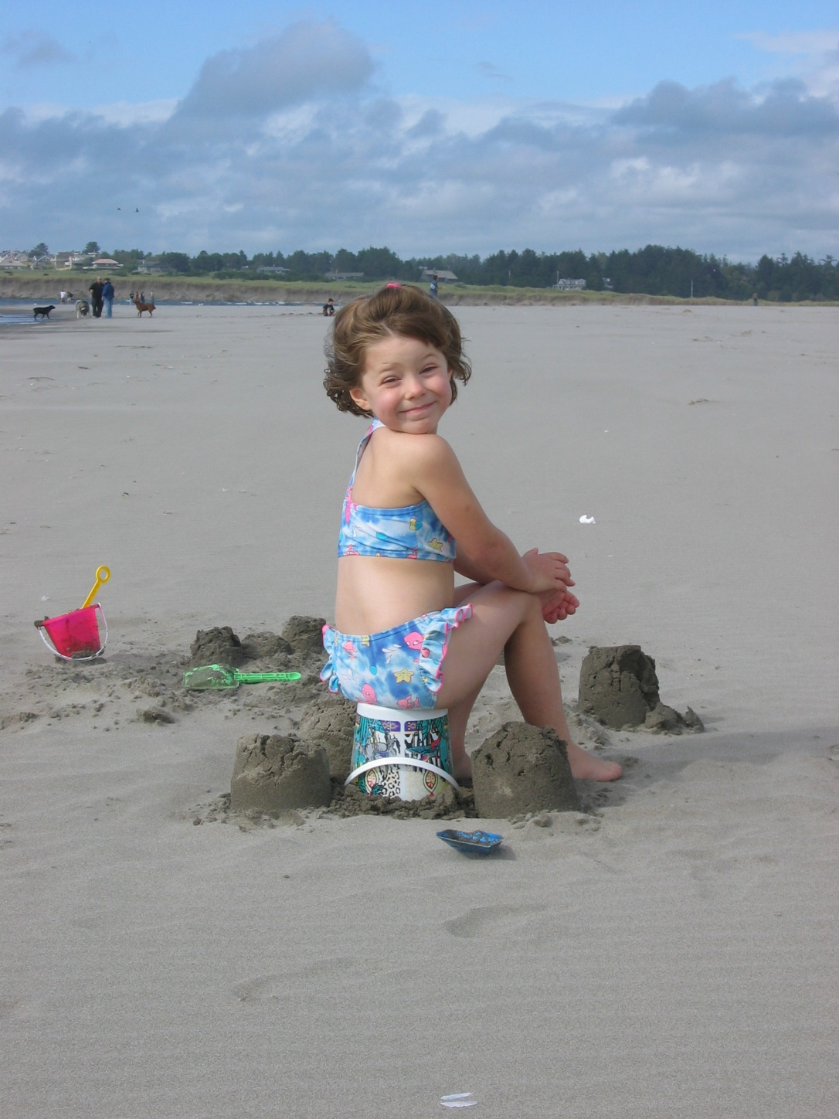
Pictures
Are you…
Please, please make a point
Perhaps only you care about your kids/dog/moose pic
sitting on the opportunity
to treat cholesterol?

Slide 42
Movies
CHECK YOUR MOVIES EVERYTIME!!!
  Different computers, different projectors
  Arrive early and check
  Changing resolution most common solution
Use Pack and Play (2007) or Package Presentation for CD (2010)
Put slides and movies in the same folder
  No subfolders!

Slide 43
Tables
BEWARE… “This is a busy slide, buuuuut…”
Make sure point is clear (colors, bold, etc.)
Can use background to highlight

Slide 44
Mega Data Slide – CHF Trials
ACEI Trials | Intervention | Follow Up | # | Inclusion Criteria | Endpoints | Results Drug | Placebo | RR | NNT | Average Follow Up (years) | RRR | ARR
CONSENSUS (Cooperative North Scandinavian Enalapril Survival Study) | Enalapril (2.5 - 40mg) vs. placebo | Mean 0.5 years | 253 | NYHA IV, cardiomegaly | Mortality | 36.2% | 52.4% | 0.69 | 3.2 | 0.5 | 31% | 16%
V-HeFT II (VA Heart Failure Trial) | Enalapril vs. Hydralazine/ISDN | 2 years | 804 | Mild-moderate CHF on digoxin/diuretics | Mortality | 14.6% | 18.0% | 0.82 | 5.4 | 2.5 | 18% | 3%
 |  |  |  |  | HF Hospitalization | 9.2% | 9.5% | -- | -- |  | 3% | 0%
SOLVD Treatment (Studies of Left Ventricular Dysfunction) | Enalapril (2.5-20mg) vs. placebo. | Mean 3.4 years | ### | EF<35% with CHF | Mortality | 10.4% | 11.7% | 0.89 | 8.8 | 3.4 | 11% | 1%
 |  |  |  |  | HF Hospitalization | 16.8% | 18.5% | 0.90 | 10.5 |  | 10% | 2%
SOLVD Prevention | Enalapril (2.5-20mg) vs. placebo. F/U 37 mo. | Mean 3.1 years | ### | Asymptomatic, EF<35% | Mortality | 4.8% | 5.1% | -- | -- | 3.10 | -- | --
 |  |  |  |  | HF Hospitalization | 4.7% | 6.3% | -- | -- |  | 26% | 2%
b-Blocker Trials¹ | Intervention | Follow Up | # | Inclusion Criteria | Endpoints | Drug | Placebo | RR | NNT |  | RRR | ARR
COPERNICUS (CarvedilOl ProspEctive RaNdomIzed CUmulative Survival) | Carvediolol (12.5-50mg/d) vs. placebo | 1 year | ### | CHF > 3 mo, EF<35% | Mortality | 11.4% | 18.5% | 0.62 | 2.6 | ??? | 38% | 7%
MERIT-HF (Metoprolol Randomized Intervention Trial in CHF) | Metolprolol (goal 200mg/d) vs. placebo | 1 year | ### | NYHA II-IV, EF <40% | Mortality | 7.2% | 11.0% | 0.65 | 2.9 | 1.0 | 35% | 4%
CIBIS-II (Cardiac Insufficiency Bisoprolol Study II) | Bisoprolol (1.25-10mg/d) vs. placebo | Mean 1.3 years | ### | NYHA III-IV, EF<35% | Mortality | 9.0% | 13.3% | 0.68 | 3.1 | 1.3 | 31.9% | 4.2%
 |  |  |  |  | HF Hospitalization | 9.2% | 13.5% | -- | -- |  | 32% | 4%
What is my point?

Slide 45
ACE Inhibitors and Mortality Reduction
Mortality
Trial
ACEI
Controls
RR (95% CI)
Chronic CHF
CONSENSUS I
39%
54%
0.56 (0.34–0.91)
SOLVD (Treatment)
35%
40%
0.82 (0.70–0.97)
SOLVD (Prevention)
15%
16%
0.92 (0.79–1.08)
Make another point with
text box or highlighting
Post MI
SAVE
20%
25%
0.81 (0.68–0.97)
AIRE
17%
23%
0.73 (0.60–0.89)
TRACE
35%
42%
0.78 (0.67–0.91)
SMILE
6.5%
8.3%
0.78 (0.52–1.12)
Average
21%
25%
0.77
Garg R et al. JAMA. 1995;273:1450–1456.

Slide 46
MSCT and Chest Pain
Author | Journal | Year | N | Slice |  | Sens | Spec | PPV | NPV | Comparison
Sato Y | Circ J | 2004 | 2 | 4 | SRO | 100 | 100 | - | - | None
Dorgelo | Eur Radiol | 2004 | 22 | ** | SRO | 94 | 96 | ** | ** | **
Ghersin E | AJR | 2004 | 66 | 16 | SRO | 80 | 89 | 52 | 97 | Cath
White CS | AJR | 2005 | 69 | 16 | TRO | 83 | 96 | 83 | 96 | Cath
Johnson TRC | AJR | 2005 | 55 | 64 | TRO | 94 | 77 | 84 | 91 | Adj. dx
Sato Y | Circ J | 2005 | 31 | 4 | SRO | 95.5 | 88.9 | - | - | Cath, MI
Gallagher MJ | Ann Em Med | 2006 | 92 | 64 | SRO | 86 | 92 | 50 | 99 | ACS/Cath 30d
Hoffmann U | AJR | 2006 | 40 | 16/64 | SRO | 100 | 74 | 38 | 100 | Adj. dx
Hoffmann U | Circulation | 2006 | 103 | 64 | SRO | 100 | 82 | 47 | 100 | Adj. dx
Savino G | Radiol Med | 2006 | 23 | 64 | TRO | - | - | - | - | Cath
Hollander JE | Ac Em Med | 2007 | 54 | 64 | SRO | - | - | - | - | Obs
Goldstein JA | JACC | 2007 | 197 | 64 | SRO | - | - | - | - | RCT, obs
 |  |  | N |  |  | Sens | Spec | PPV | NPV
AVERAGE |  |  | 754 |  |  | 91 | 87 | 59 | 98
AVERAGE (64 slice) |  |  | 250 |  |  | 94 | 85 | 56 | 98

Slide 47
Charts and Graphs
They should inform with a single glance
Slide contents should be self evident, but explain anyway
  Take audience thorough slide
Delete extraneous stuff (backgrounds, lines, etc.)

Slide 48
Neurohormonal Axis
Myocardial injury to the heart (CAD, HTN, CMP, Valvular disease)
Initial fall in LV performance, ↑ wall stress
Activation of RAAS and SNS
Fibrosis, apoptosis,
hypertrophy, cellular/
molecular alterations,
myotoxicity
Remodeling and progressive
worsening of LV function
Peripheral vasoconstriction
Hemodynamic alterations
Heart failure symptoms
Morbidity and mortality
Arrhythmias
Pump failure
Fatigue
Activity altered
Chest congestion
Edema
SOB
RAAS = renin-angiotensin-aldosterone system; SNS = sympathetic nervous system.

Slide 49
US Carvedilol Heart Failure Program:
Effect on Hospitalizations
Placebo
(n = 398)
Carvedilol
(n = 696)
⇓ 29%*
⇓ 28%*
⇓ 38%*
30
*P <.05
20
Duration of therapy:
6.5 months (median)
%
10
0
All
Hospitalizations
Cardiovascular
Hospitalization
Heart Failure
Hospitalizations
Fowler MB et al. J Am Coll Cardiol. 2001;37:1692–1699.

Slide 50
Charts and Graphs
Try not to use charts/graphs from journals
Can use animation for impact

Slide 51
PROSPER Study

Slide 52
Prevalence of CHF by Gender and Age (NHANES Survey)
Schocken DD, et al., J Am Coll Cardiol, 1992;20:301

Slide 53
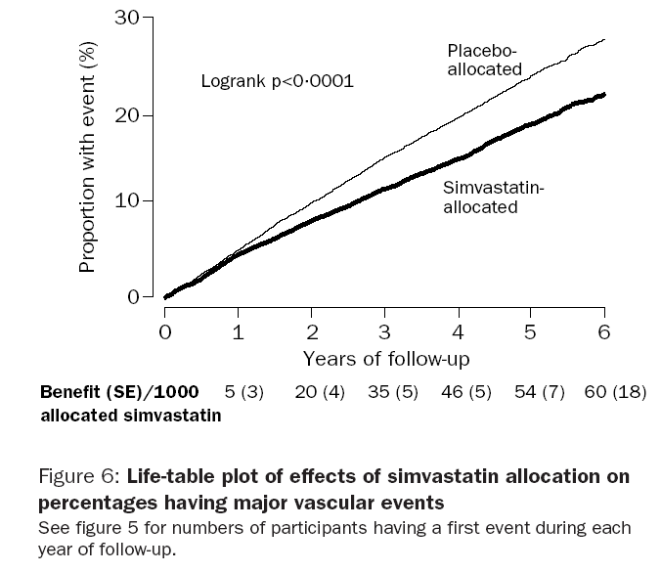
Heart Protection Study: Major Vascular Events
Heart Protection Study Collaborative Group. Lancet 2002;360:7–22.

Slide 54
HPS: Major Vascular Events by Year
P<0.0001
Placebo
People Suffering Events (%)
Simvastatin
0
1
2
3
4
5
6
Years of Follow-up
5 (3)
20 (4)
35 (5)
46 (5)
54 (7)
60 (18)
Benefit/1000 (SE):
Heart Protection Study Collaborative Group. Lancet 2002;360:7–22.
Notes:
Simvastatin: major vascular events by year (graph)
After the first year, there were highly significant reductions of about one quarter in the event rates during each year. This leads to continued divergence of the lines in this life-table plot of the effect of simvastatin on the incidence of a first major vascular event, which implies that benefits would increase with longer duration of treatment and follow-up.
Reference:
Heart Protection Study Collaborative Group. MRC/BHF Heart Protection Study of cholesterol lowering with simvastatin in 20 536 high-risk individuals: a randomised placebo-controlled trial. Lancet 2002;360:7-22.

Slide 55
HPS: Major Vascular Events by Year
P<0.0001
Placebo
People Suffering Events (%)
Simvastatin
0
1
2
3
4
5
6
Years of Follow-up
5 (3)
20 (4)
35 (5)
46 (5)
54 (7)
60 (18)
Benefit/1000 (SE):
Heart Protection Study Collaborative Group. Lancet 2002;360:7–22.
Notes:
Simvastatin: major vascular events by year (graph)
After the first year, there were highly significant reductions of about one quarter in the event rates during each year. This leads to continued divergence of the lines in this life-table plot of the effect of simvastatin on the incidence of a first major vascular event, which implies that benefits would increase with longer duration of treatment and follow-up.
Reference:
Heart Protection Study Collaborative Group. MRC/BHF Heart Protection Study of cholesterol lowering with simvastatin in 20 536 high-risk individuals: a randomised placebo-controlled trial. Lancet 2002;360:7-22.

Slide 56
HPS: Major Vascular Events by Year
RR 24%
ARR 5.4%
NNT 19
P<0.0001
Placebo
People Suffering Events (%)
Simvastatin
0
1
2
3
4
5
6
Years of Follow-up
5 (3)
20 (4)
35 (5)
46 (5)
54 (7)
60 (18)
Benefit/1000 (SE):
Heart Protection Study Collaborative Group. Lancet 2002;360:7–22.
Notes:
Simvastatin: major vascular events by year (graph)
After the first year, there were highly significant reductions of about one quarter in the event rates during each year. This leads to continued divergence of the lines in this life-table plot of the effect of simvastatin on the incidence of a first major vascular event, which implies that benefits would increase with longer duration of treatment and follow-up.
Reference:
Heart Protection Study Collaborative Group. MRC/BHF Heart Protection Study of cholesterol lowering with simvastatin in 20 536 high-risk individuals: a randomised placebo-controlled trial. Lancet 2002;360:7-22.

Slide 57
CASE STUDIES
Use them
Be as simple as possible
Make sure you emphasize a point

Slide 58

Case Study
A 71 year-old male with metastatic melanoma on the left shoulder, discovered 12/94.
Original Diagnosis
A CT performed on 7/10/95 demonstrated a tumor of the distal femur and adjacent soft tissue with negative findings in the abdomen. A bone scan from 7/13/95 showed on abnormal femur and four spine lesions.
PET Findings
History
A whole-body FDG PET scan demonstrated numerous lesions throughout the body.
Change in Treatment
The patient was scheduled for an amputation based on CT and bone scan results. After the PET scan found multiple lesions, surgery was cancelled, avoiding both the cost and the trauma of an operation that would not have been effective.

Slide 59
CASE PRESENTATION
23 year old woman presents with acute onset of dyspnea, orthopnea and chest discomfort
  G₁P₀ at 11 weeks gestation
Congenital mitral regurgitation, mitral valve replaced at age 5 with 23 mm St. Jude’s prosthesis
Converted from coumadin 5 mg per day to SQ heparin, 1 mg/kg BID at 5 weeks gestation
What are risks of warfarin versus SQ heparin?

Slide 60
Tips and Tricks
The internet is chock full of slides
Find a background you like and stick with it
Keep a formatted set of charts, bar graphs
  Replacing existing graphs/tables always looks better, if possible
Cut and paste is your friend

Slide 61
Tips and Tricks
Avoid “lecturalgia”
Know your audience
Redundancy is good

Slide 62
Tips and Tricks
Avoid “lecturalgia”
Know your audience
Redundancy is good

Slide 63
Tips and Tricks
Avoid “lecturalgia”
Know your audience
Redundancy is good

Slide 64
Summary
10% Rule – Highlight the 10%
Tell them you are going to tell them, tell them, and tell them you told them
Think Haiku, enthusiasm is infectious

